Slide 1
Introduction to MongoDB
Server Startup

Slide 2
Installation and Startup
Getting the software
Installation
Running the server

Slide 3
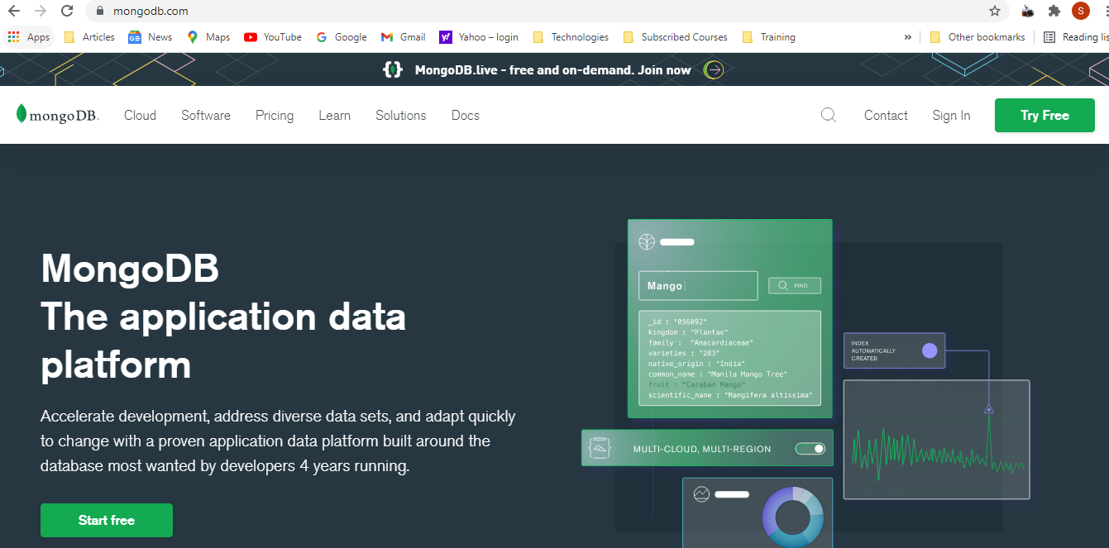

Slide 4
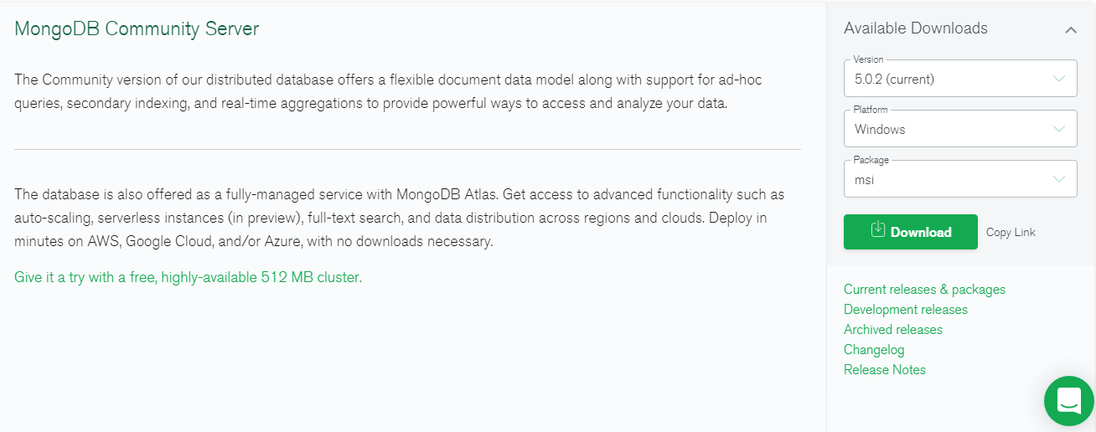

Slide 5
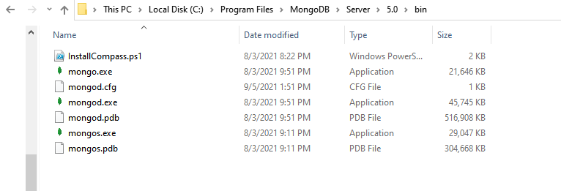

Slide 6
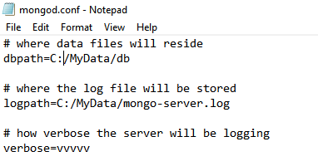

Slide 7


Single Server Danger
Primary DB
Backup

Slide 8
Replica Set
Primary DB
Secondary DB
Arbiter DB
Minimal Replica Set in
MongoDB

Slide 9




Replica Set Demo
A
B
C
Primary DB
Secondary DB
Arbiter DB

Slide 10
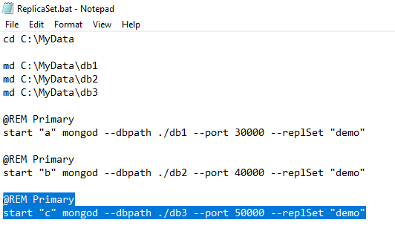

Slide 11
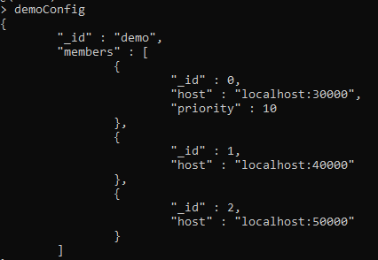
JavaScript object as configuration for our replica set

Slide 12
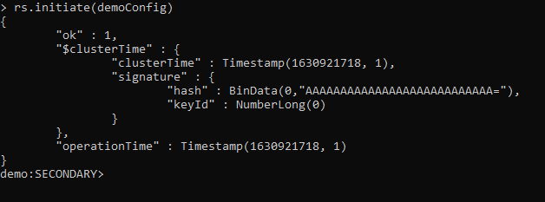
Initiate the replica set

Slide 13
Summary
Get it:
http://mongodb.org
Install it:
Command line
Install as a service
Connect to it:
The Mongo shell
Replica Set:
Minimal setup
Failover

